Slide 1
Accelerating Data-Intensive Seismic Research Through Parallel Workflow Optimization and Federated Cyberinfrastructure
Authors: Marcus Adair, Ivan Rodero, Manish Parashar, and Diego Melgar
Presenter: Marcus Adair

Slide 2




Marcus Adair
Primary Author
1st year MS Computer Science student
Presenting research from my undergrad
University of Utah,
Scientific Computing and Imaging (SCI) Institute

Slide 3

Introduction
Earthquake early warning (EEW):
Machine learning (ML)
Predict earthquake magnitude (Mw)
Better-informed decision making
Large events are rare so synthetic data is used in training
Synthetic data from large (Mw 7.5+) earthquake simulations has proven valuable in training AI-based earthquake early warning (EEW) models
MudPy (Multi Data Source Modeling and Inversion Toolkit in Python) (Melgar et al.)
Synthesizes data for training models
Simulates earthquake ruptures and GNSS satellite waveforms (FakeQuakes)
Other functions (e.g., model tsunamis)
Marcus Adair

Slide 4
Introduction
MudPy (FakeQuakes) Limitations:
Running simulations can take days (sequential generation)
Not user-friendly
No current platform for easy discovery and broad sharing of generated data
These can hinder the the broad adoption of MudPy, especially for non-programmers!
Research Goals:
Address above limitations through parallel workflow (FDW)
Facilitate efficient data access for interdisciplinary research communities
Contribute to fully unleashing the potential of data and AI for societal impacts (EEW)
Marcus Adair

Slide 5
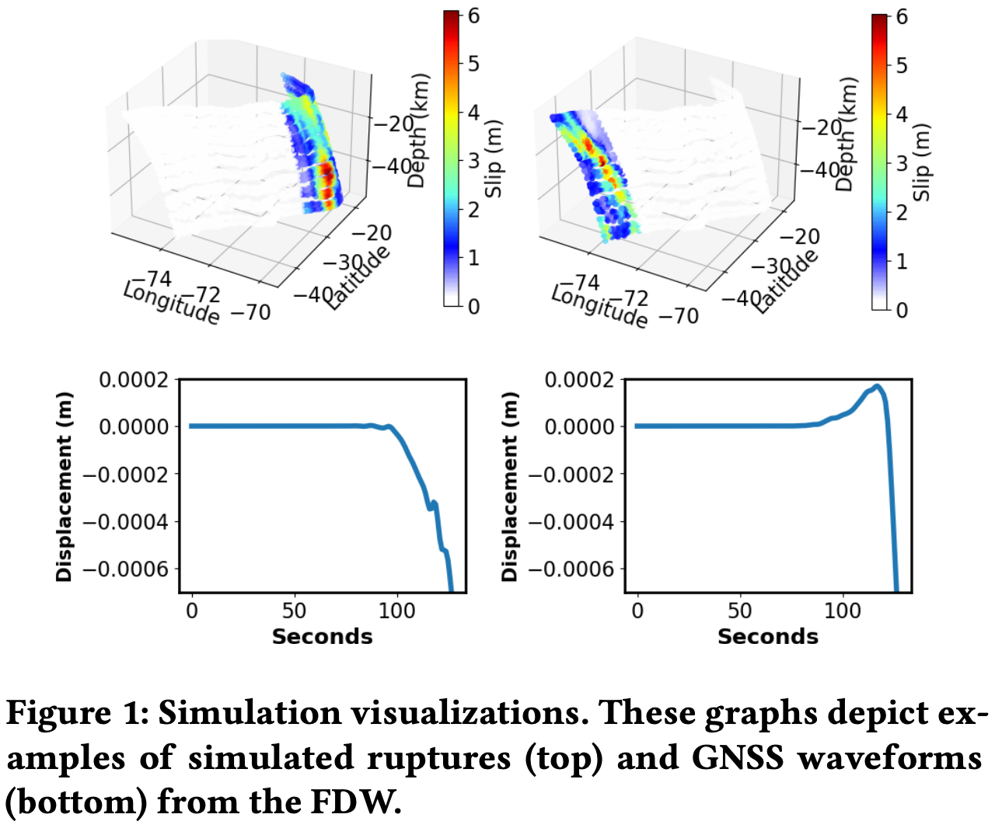
Related Work
- A grad student in Spain researched whether GPUs, Cuda, and MudPy code modifications could accelerate MudPy
10% improvement, deemed not feasible
[Carillo, 2019]
FakeQuakes waveforms recently used in training a model to predict the magnitude of 5 real, large earthquakes in Chile.
Outperformed similar approaches
Prior successful models didn’t focus on large earthquakes
36,800 FakeQuakes waveforms used in training
20+ day generation
[“Early Warning for Great Earthquakes From Characterization of Crustal Deformation Patterns With Deep Learning” Lin et al., 2021]
MudPy uses MPI
- FakeQuakes waveforms have been validated against actual events [Goldberg and Melgar, 2020]
Confirmed via demonstration of good agreement with real data in the frequency and time domains
Marcus Adair

Slide 6



Background
Open Science Grid (OSG)
High Throughput Computing (HTC)
Dedicated to open science
Shared resources contributed by universities, government-support SC institutions, and more
Custom workflows
Virtual Data Collaboratory (VDC)
Federated Data Cyberinfrastructure (CI)
NSF-funded
Supports interdisciplinary, collaborative research
Efficient access to data and data services (e.g., metadata curation and data discovery)
Web interface and API
Marcus Adair

Slide 7
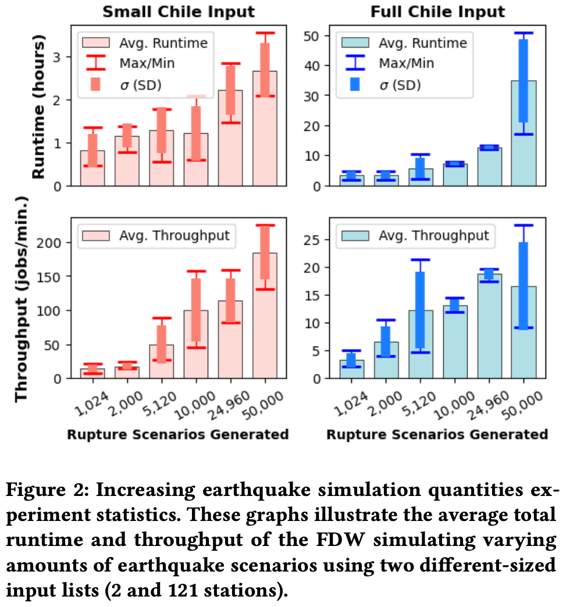
Increasing Earthquake Simulation Quantities Experiment
6 waveform amounts
1,024, 2,000, 5,120, 10,000, 24,960, 50,0000
Simulated earthquakes in Chile
2 input sizes
(small: 2 GNSS stations, full 121 stations)
Runtime, throughput, min/max, std. dev
Aimed to gain insight into feasibility of OSG
Results (Full Input):
~5x throughput increase (1,024 to 50,000)
24,960 waveforms in 12.5 hrs
50,000 in < 35 hours
Higher result variability for 50,000 waveforms
Marcus Adair

Slide 8




FakeQuakes DAGMan Workflow (FDW)
Additional Technologies:
Singularity (now Apptainer)
Conda
Bash, Python
Open Science Grid (OSG)
HTC
Parallelized rupture and waveform simulation
HTCondor
Utilized DAGMan (HTCondor job scheduling engine)
simple/lightweight default
Met OSG Criteria
Ideal:
1,000s of jobs
Each < 10 hrs
< 4 CPU cores
Still Advantageous:
Input < 10 GB
(< 500 MB ideal)
Git: https://github.com/Marcus-Adair/Accelerating-Data-Intensive-Seismic-Research-Through-Parallel-Workflow-Optimization-and-Federated-CI
*Must have an OSG Connect Account
Marcus Adair

Slide 9
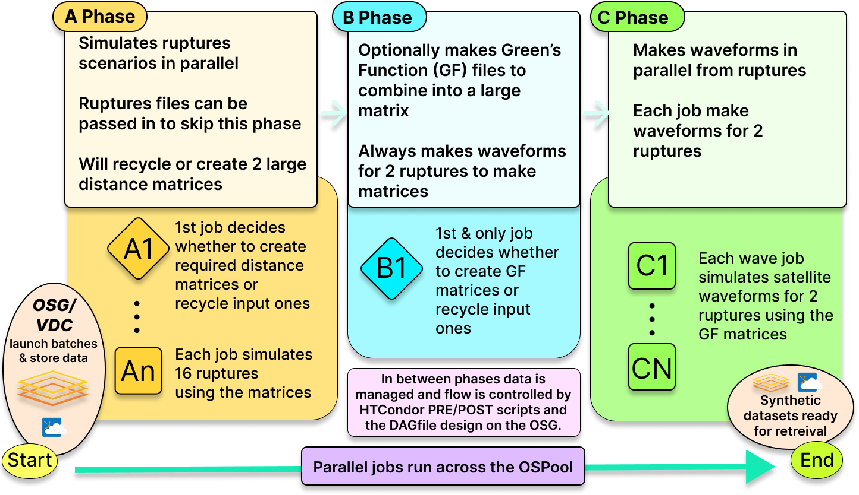
FakeQuakes DAGMan Workflow (FDW)
FDW flow:
Marcus Adair

Slide 10
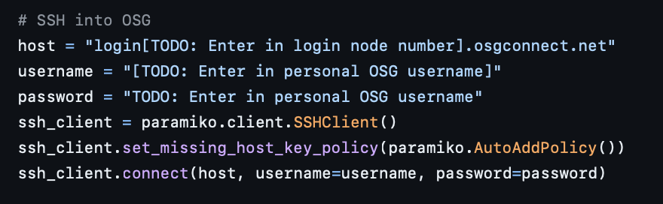
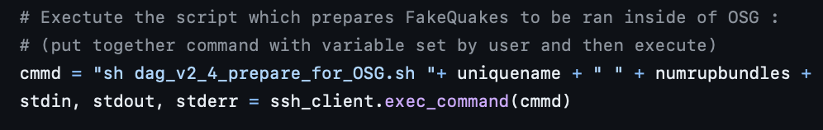
“Remotely” Running FDW
Created system to launch FDW workload via AWS machine
- FDW can be ran without manually logging in to OSG
Launched concurrent workloads
Spoke to OSG about ‘dummy’ account for FDW service
Python automating connecting to OSG:
New OSG Updates
Login requires 2FA
Further work required for integrating FDW with web interface
Code to to prepare and launch FDW batches:
Marcus Adair

Slide 11
Concurrent HTCondor DAGMans Experiment
Is partitioning OSG workloads into multiple concurrently running DAGMans beneficial?
Generated 16,000 waveforms
Used full Chile input
Partitioned FDW workloads in 1, 2, 4, and 8 DAGMans
Aimed to gain insight into OSG workload optimization
Marcus Adair

Slide 12
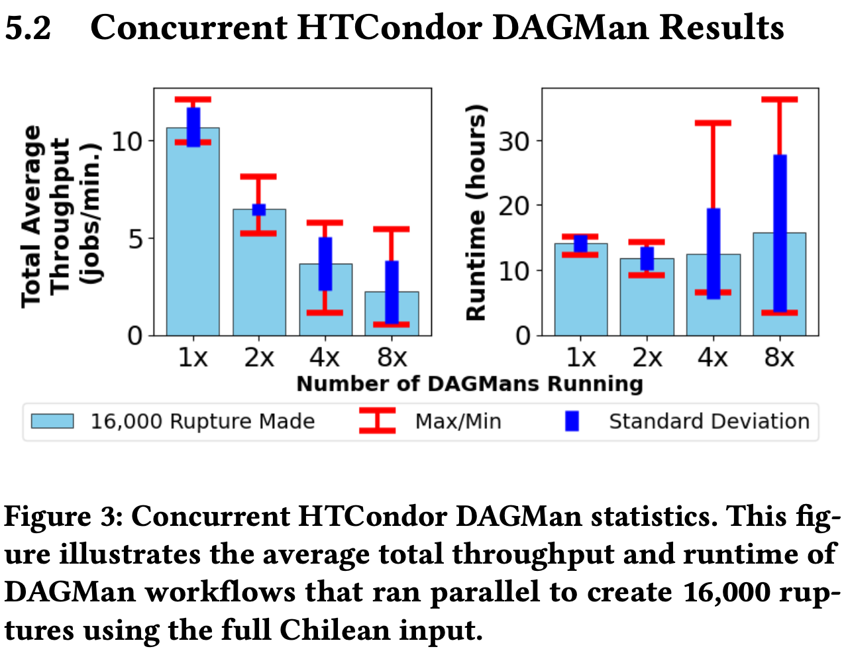
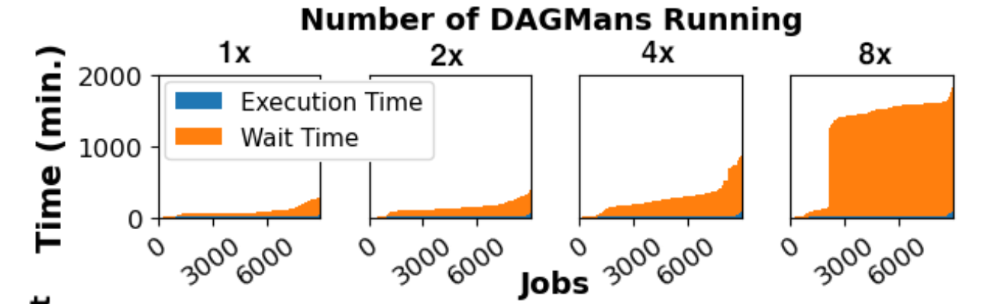
Concurrent HTCondor DAGMans Results
Runtime stayed similar despite fewer jobs per individual DAGMan when partitioned
As more DAGMans ran at the same time, throughput decreased and wait times increased
Average DAGMan Throughput and Runtime:
Individual Job Wait Times Sorted (~9,000 jobs):
Marcus Adair

Slide 13
Cloud Bursting (VDC Bursting) Simulation Framework
OSG-Tailored Policies:
Policy 1: Periodically evaluated if the instant throughput of the batch falls below a threshold → Cloud burst if low
Policy 2: Regularly analyze submitted OSG jobs and assess their queue duration → Cloud burst if queued too long
Policy 3: Monitor the timestamp of the most recent job added to the queue → Cloud burst if gap too long.
Python
Simulated OSG job offloading
CSV file input with batch and individual job time stats
Loop to monitor every second of DAGMan batch while assessing job times (submission, execution, termination)
Assessed OSG throughput and queue
- Ran FakeQuakes on AWS to collect simulated Cloud-job-times:
16 ruptures: 287 sec., 2 waveforms: 144 sec.
Chose AWS due to VDC’s ability to integrate with it
Marcus Adair

Slide 14
VDC Bursting Experiments
Can OSG workflows be effectively accelerated with additional Cloud resources?
Used 2 actual DAGMan batch results as input to simulator
16,000 waveforms
Evaluated Policies 1 and 2
(offloading probe-times and max-queue times)
Simulated Cloud cost (Amazon AWS prices: 0.0017$ per min.)
Looked at instant throughput, batch runtimes, std. devs, and the percentage of jobs simulated to be ran on Cloud resources vs. OSG
Aimed to not burst > 30% of jobs
Marcus Adair

Slide 15
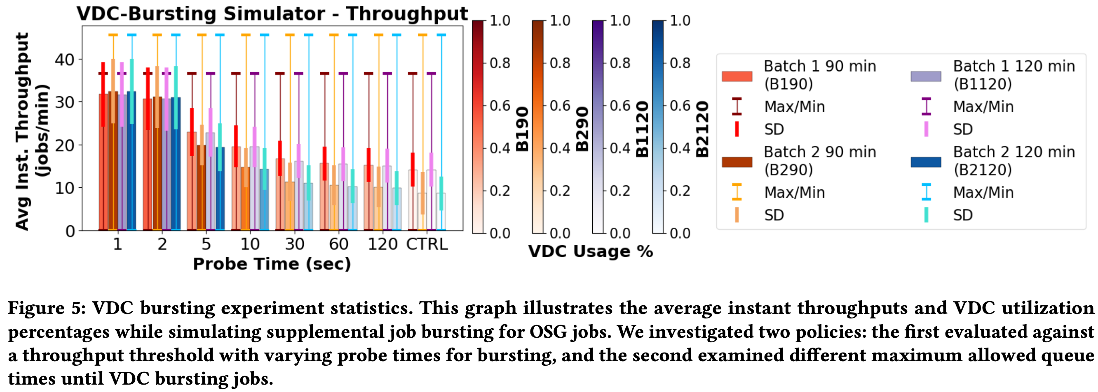
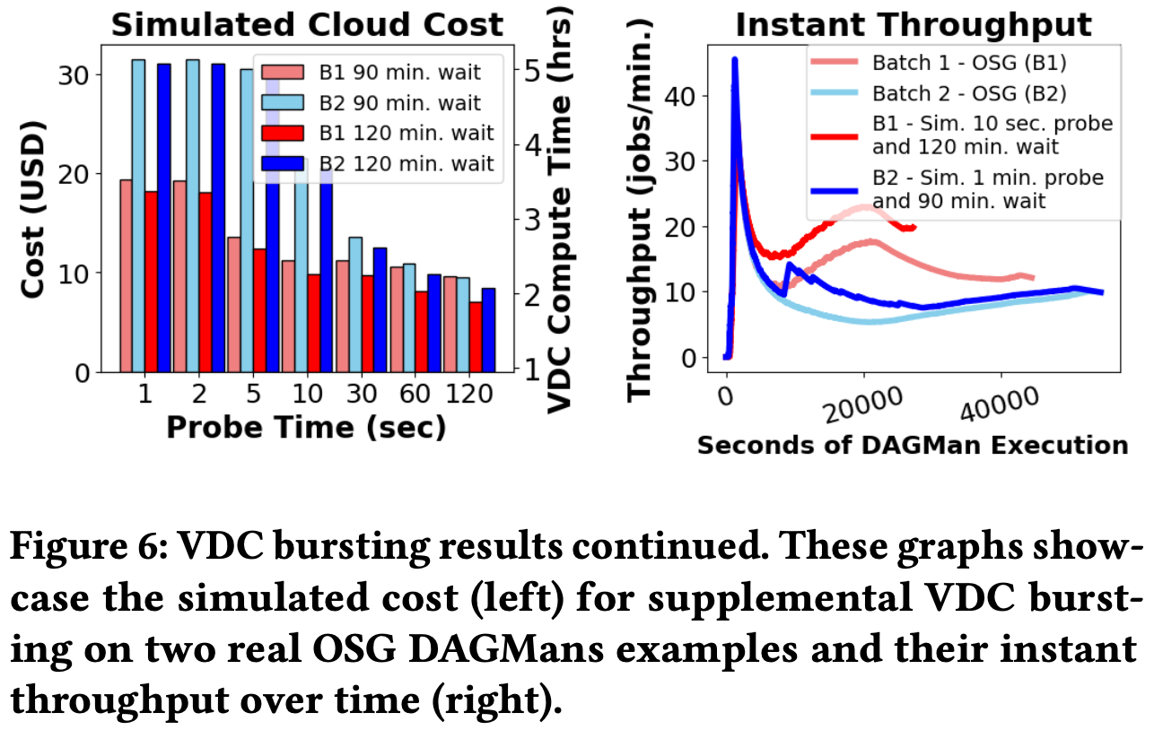
VDC Bursting Simulation Results
Interesting result with 10 sec prob and 120 min max-queue
Interesting result with 10 sec prob and 120 min max-queue (B1)
Policy 1 had the greatest effect (probe time for offloading jobs based on throughput)
Reasonable cost < 14$ (under bursting limit)
38.7% decrease in runtime while bursting < 30% of jobs (Batch 1)
Batch 2 didn’t see feasible improvement under bursting limit
Marcus Adair

Slide 16
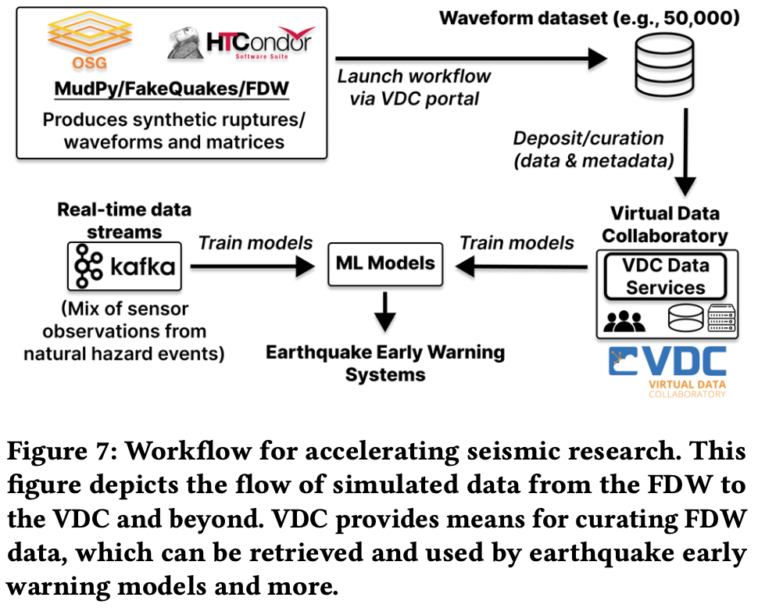
Discussion
50,000 waveforms made in < 1.5 days vs. 20+ day generation of 36,800 previously in Oregon
56.8% decrease in runtime when running 50,000 simulations with FDW vs. 1,024 with single machine
Parallelization of FakeQuakes deemed feasible
FDW excelled at high amounts of simulation (~5x throughput increase)
Found opportunities for accelerating OSG workloads (bursting)
First step of integrating MudPy into VDC
Marcus Adair

Slide 17
Conclusion and Future Work
Future Work
Experimenting with regions beyond Chile
Helping researchers leverage existing datasets and create new ones
Integrate with VDC
Conclusion
Significant reduction in execution time for 10s of 1,000s of simulations
Successful
Partitioning HTCondor DAGMan workloads is not optimal
Further elaboration on VDC Bursting model required (offloading OSG)
Marcus Adair

Slide 18
Thank You! Questions?
Marcus Adair

